Slide 1

Code Refactoring and Bug Fixing
Done by- Sushma.M

Slide 2
Scenario: A dedicated team of aspiring data scientists set out on a journey to create a cutting-edge Note Taking application leveraging Python, Flask, and HTML. Despite their passion, their limited expertise in backend development posed obstacles in achieving full functionality for the application. Acknowledging your adeptness in backend development, you've been assigned the crucial role of rectifying the code issues and guaranteeing the flawless operation of the application.
Task:
The task at hand is to optimize and stabilize the current codebase of the Note Taking Application, focusing on resolving any existing issues to ensure its smooth operation. This involves identifying and rectifying bugs present within the application while maintaining the existing structure. It's essential to thoroughly document all bugs encountered during the debugging process to facilitate a clear understanding of the changes made. The objective is not to start from scratch but rather to enhance the functionality and reliability of the existing application.

Slide 3
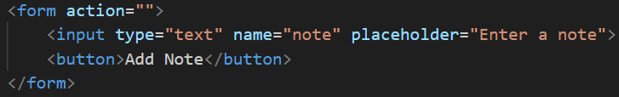
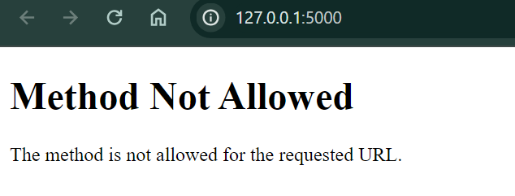
Identifying and Resolving the Bugs in the Initial Code
The initial state of the Flask Application is depicted in the following code snippets. Figures 1 and 2 reveal identifiable bugs that significantly impact the functionality of the application. Hence, it's imperative to implement the necessary changes to rectify these bugs and ensure the smooth execution of the application.

Slide 4
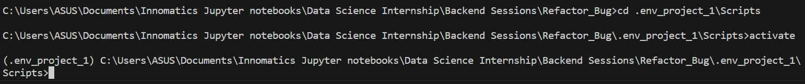
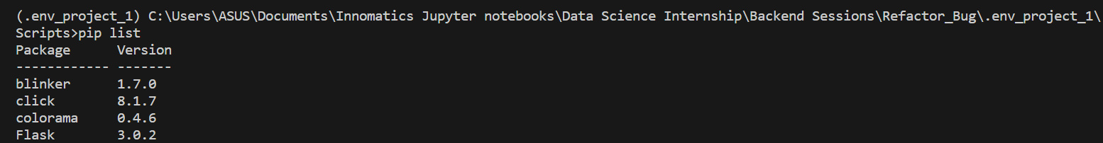
Creating a Virtual Environment
Steps for Code Refactoring and Bug fixing

Slide 5
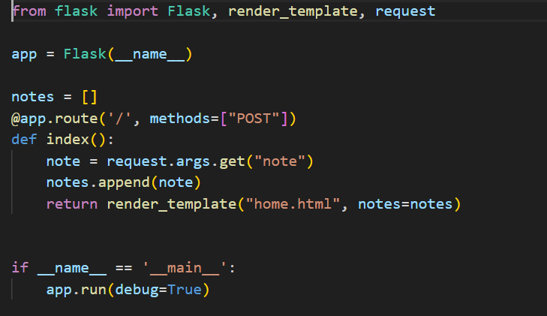
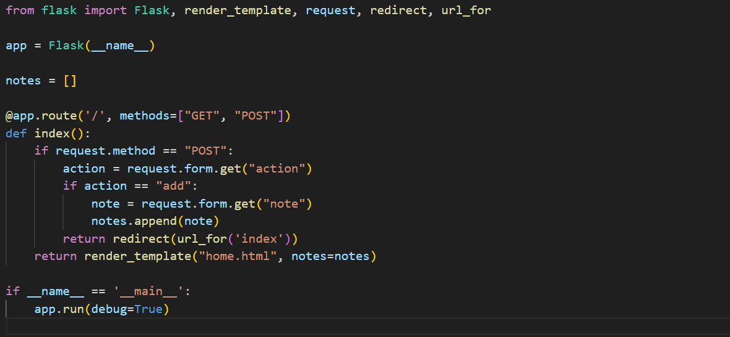
Before correction: After correction:
Recognizing and rectifying errors in the Python code:

Slide 6
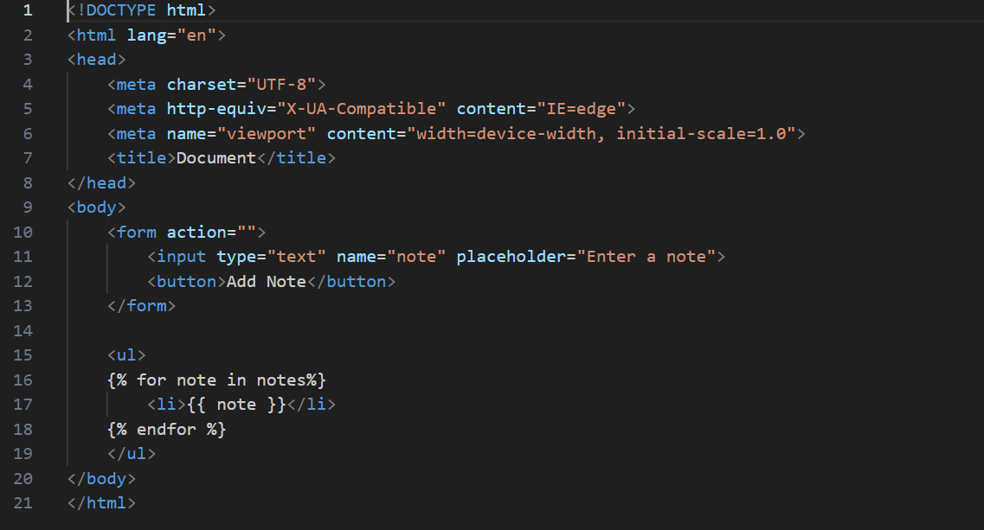
Before correction:
Identifying and correcting the Bugs in the HTML Code :

Slide 7
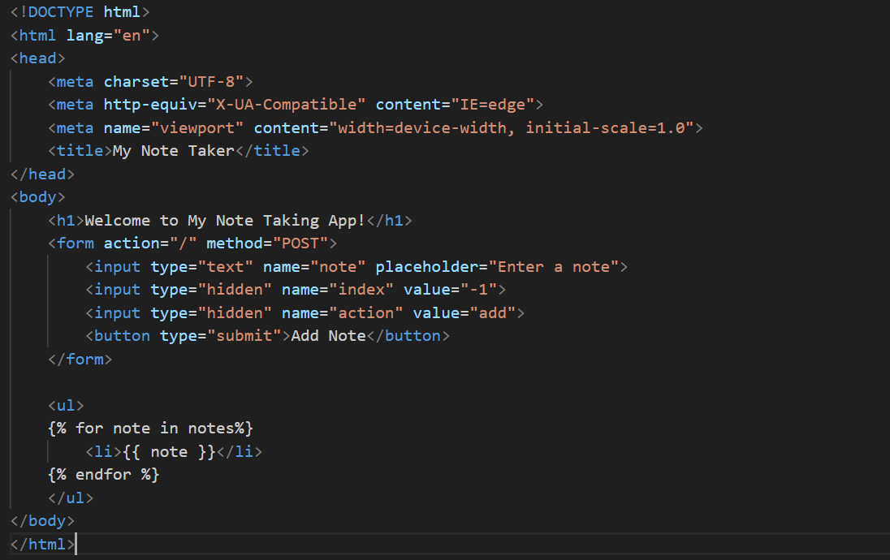
After correction:

Slide 8
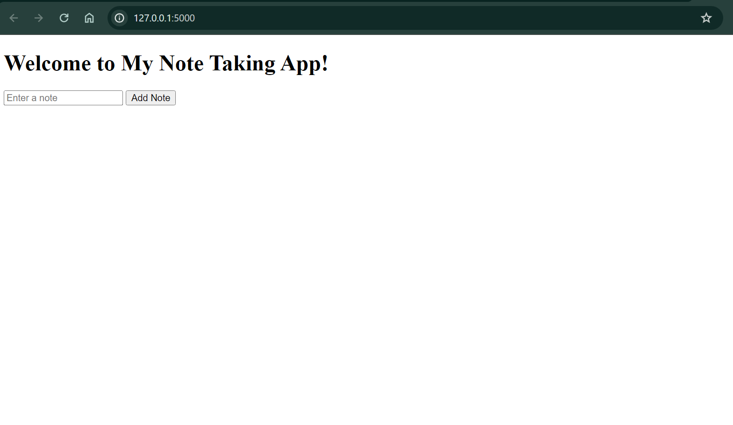
Final web-Application:

Slide 9

THANK YOU

